Slide 1
OSI Physical Layer

Slide 2
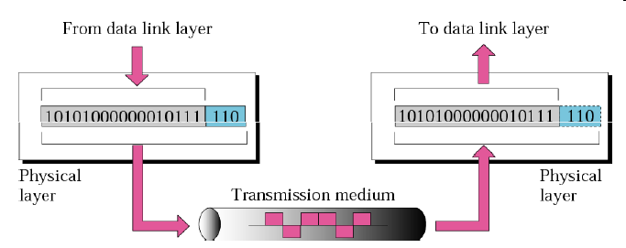
Physical Layer Services
The role of the OSI Physical layer is to encode the binary digits that represent Data Link layer frames into signals and to transmit and receive these signals across the physical media - copper wires, optical fiber, and wireless - that connect network devices.

Slide 3
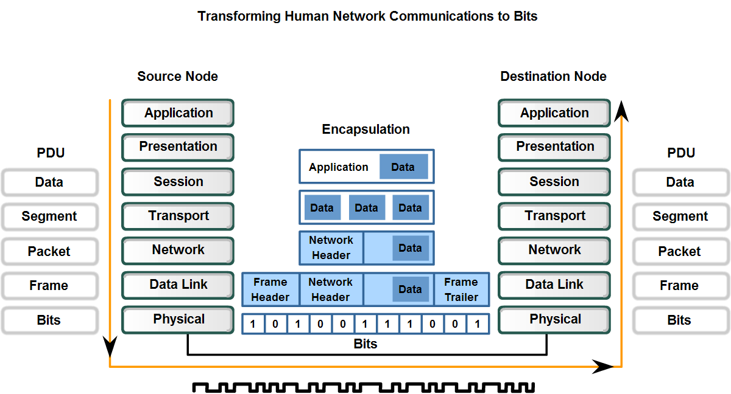
The purpose of the Physical layer is to create the electrical, optical, or microwave signal that represents the bits in each frame. These signals are then sent on the media one at a time.
It is also the job of the Physical layer to retrieve these individual signals from the media, restore them to their bit representations, and pass the bits up to the Data Link layer as a complete frame.

Slide 4
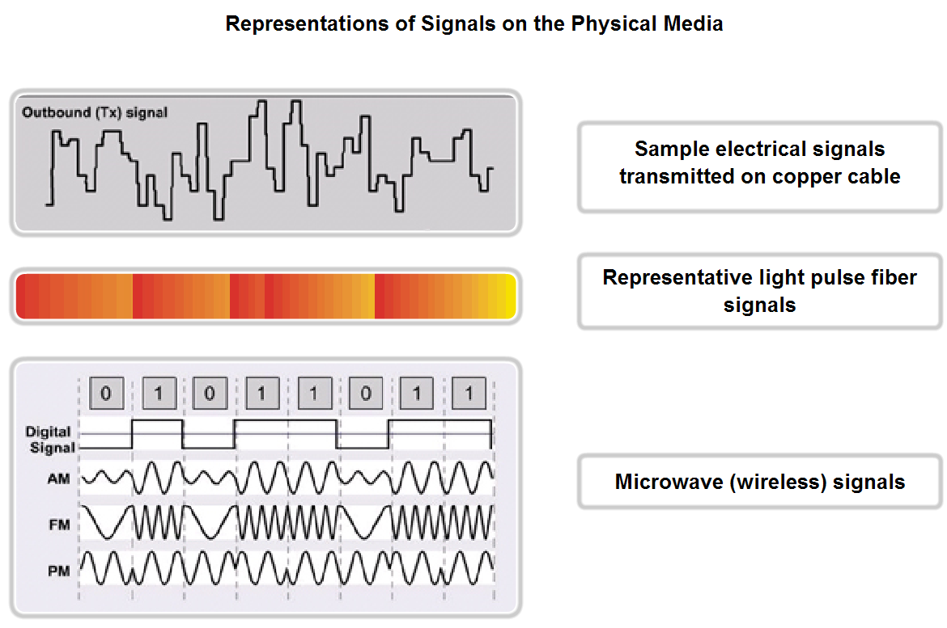

Slide 5
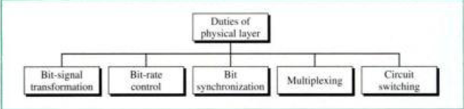

Slide 6
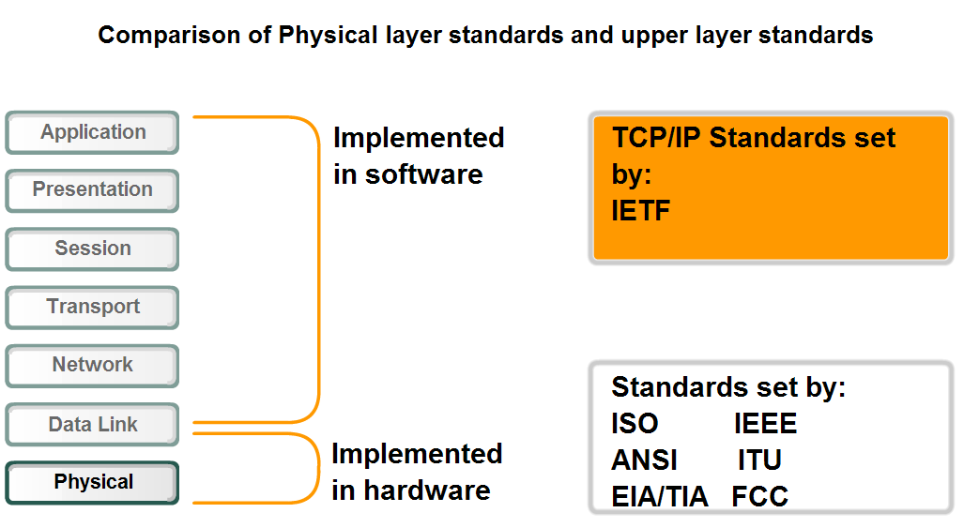
Physical Layer Technologies
The Physical layer technologies are defined by organizations such as:
The International Organization for Standardization (ISO)
The Institute of Electrical and Electronics Engineers (IEEE)
The American National Standards Institute (ANSI)
The International Telecommunication Union (ITU)
The Electronics Industry Alliance/
Telecommunications Industry Association (EIA/TIA)
National telecommunications authorities such as the Federal Communication Commission (FCC) in the USA.
The technologies defined by these organizations include four areas of the Physical layer standards:
Physical and electrical properties of the media
Mechanical properties (materials, dimensions, pinouts) of the connectors
Bit representation by the signals (encoding)
Definition of control information signals

Slide 7
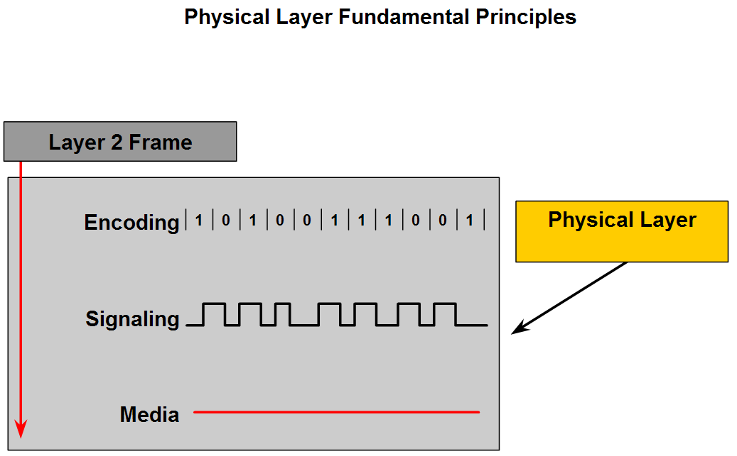
The three fundamental functions of the Physical layer are:
Physical components
Data encoding
Signaling
Physical elements are the electronic hardware devices, media and connectors other that transmit and carry the signals to represent the bits.
Encoding is a method of converting a stream of data bits into a predefined "code.
The Physical layer must generate the electrical, optical, or wireless signals that represent the "1" and "0" on the media. The method of representing the bits is called the signaling method.

Slide 8
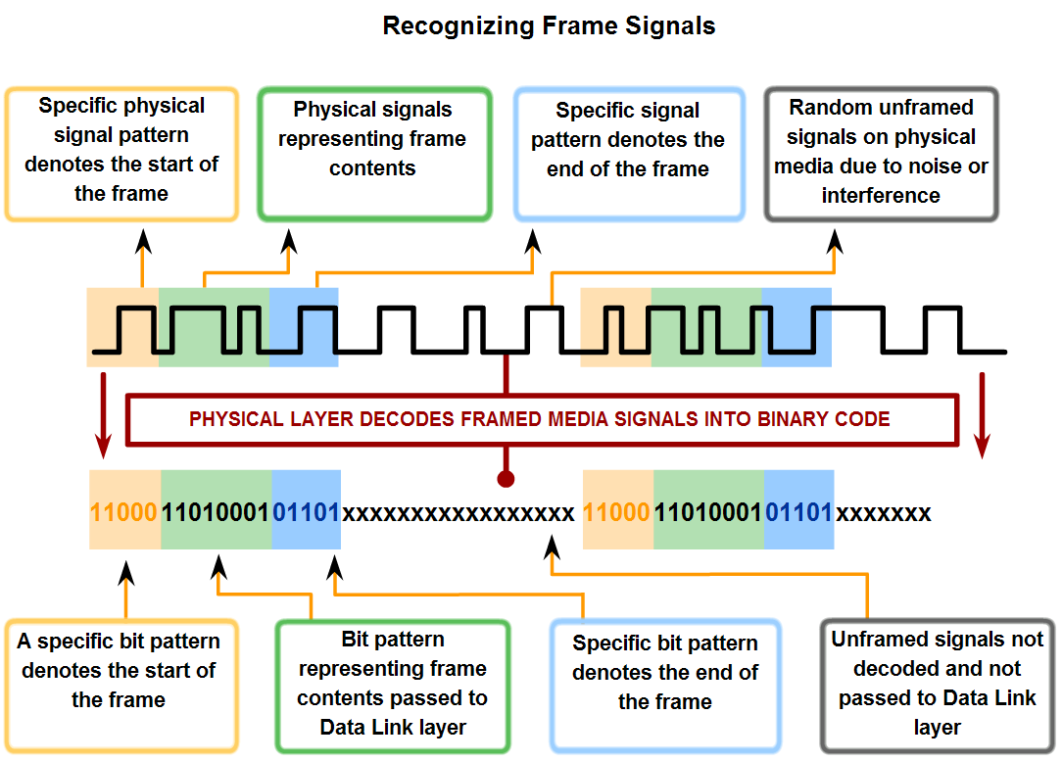
Physical Layer Signaling and Encoding

Slide 9
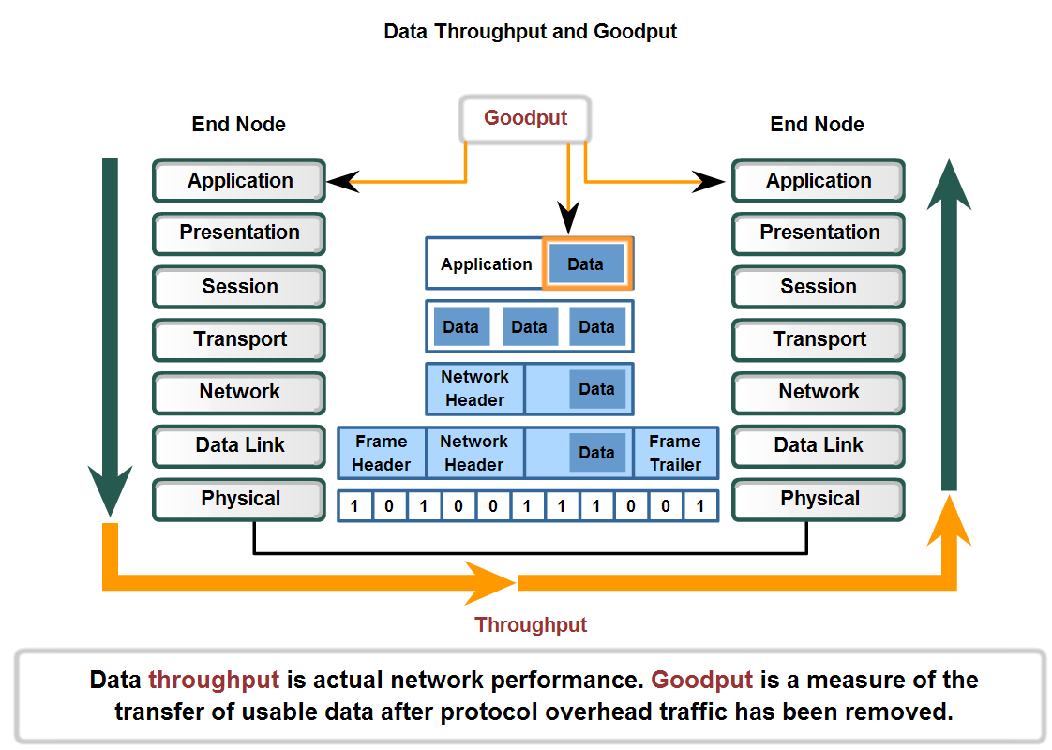
Physical Layer Signaling and Encoding
Bandwidth, Throughput, and Goodput

Slide 10
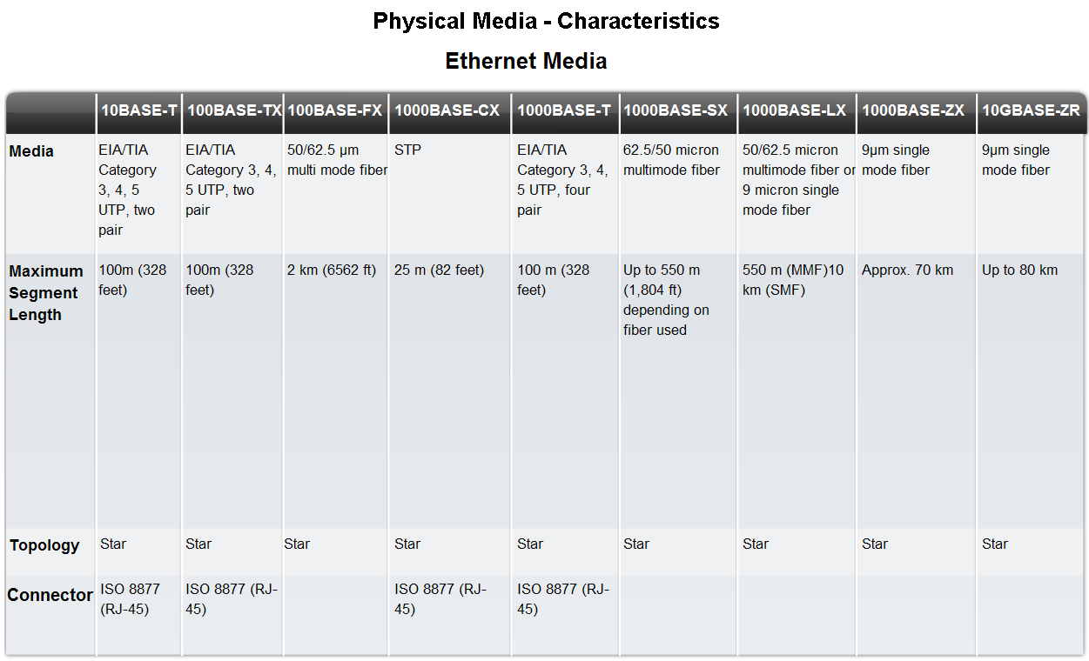

Slide 11
Characteristics & Uses of Network Media
Wireless Media
Standard | Bluetooth 802.15 | 802.11(a,b,g,n) | 802, 11, MMDS, LMDS | GSM, GPRS, CDMA
Speed | <1 Mbps | 1 - 54 + Mbps | 22 Mbps+ | 10- 384 Kbps
Range | Short | Medium | Medium- long | Long
Application | Peer-to-peer device-to-device | Enterprise networks | Fixed, last mile access | PDAs, Mobile phones, Cellular access
LMDS – Local Multipoint Distribution Service
MMDS – Multichannel Multipoint Distribution Service
GSM – Global System for mobile communication
GPRS –General Packet Radio Service
CDMA – Code Division Multiple Access

Slide 12
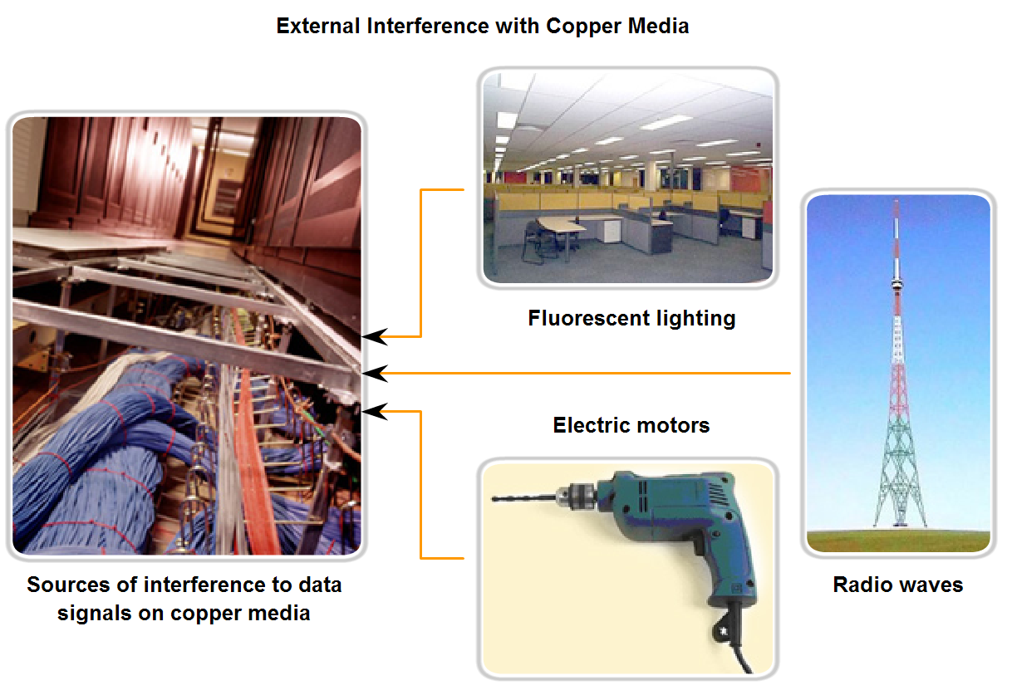
Characteristics & Uses of Network Media

Slide 13
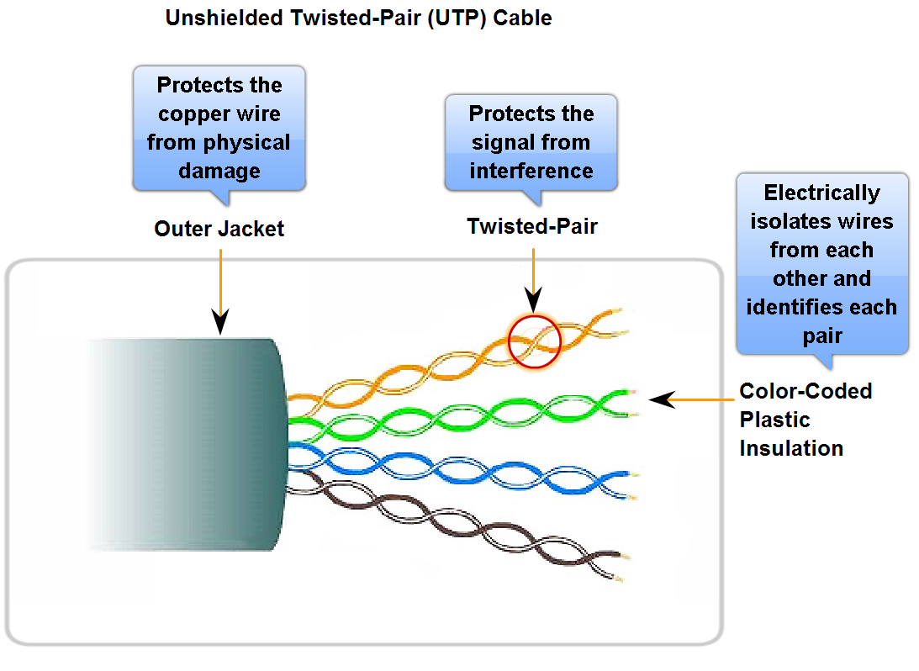
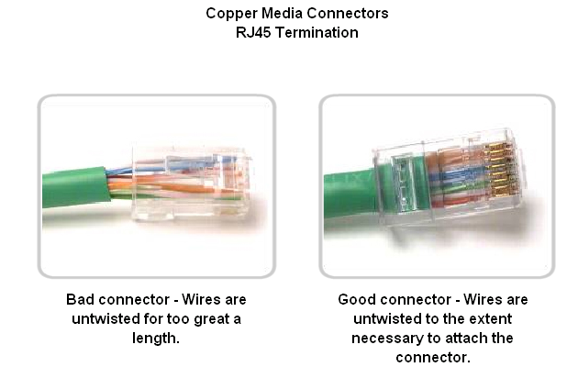
Characteristics & Uses of Network Media
UTP cable

Slide 14
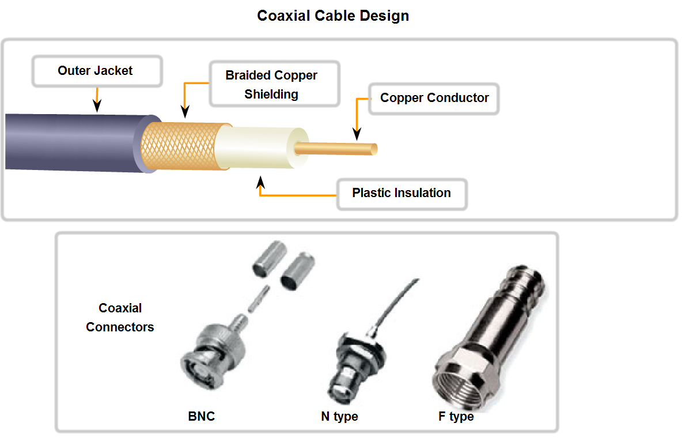
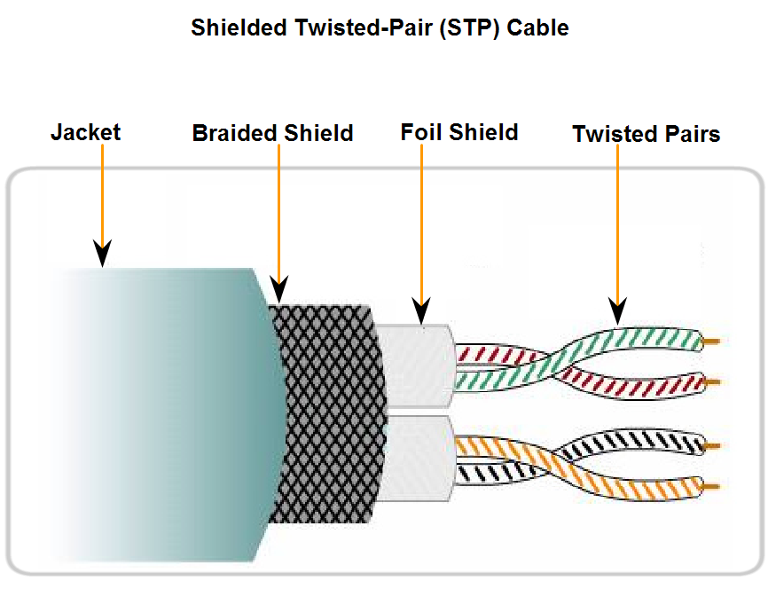
Characteristics & Uses of Network Media
Coaxial cable and STP
Bayonet Neill–Concelman

Slide 15
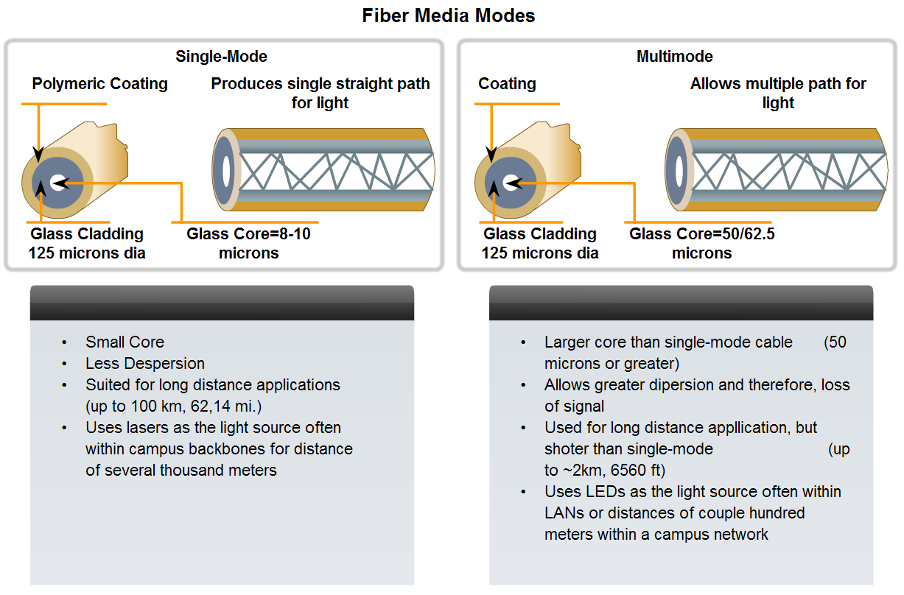
Characteristics & Uses of Network Media
Fiber cabling and its main advantages over other media

Slide 16
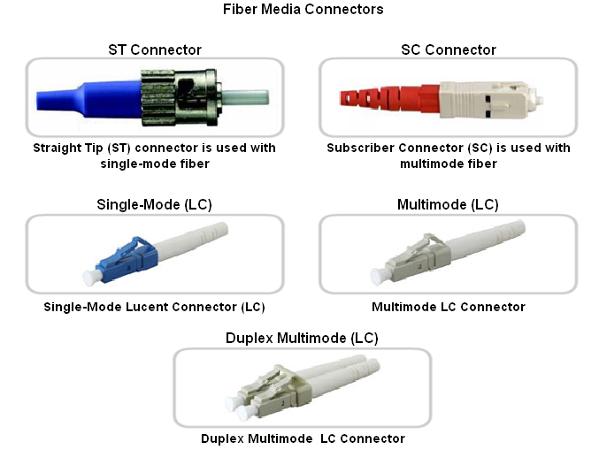
Characteristics & Uses of Network Media
Straight-Tip (ST) (trademarked by AT &T) - a very common bayonet style connector widely used with multimode fiber.
Subscriber Connector (SC) - a connector that uses a push-pull mechanism to ensure positive insertion. This connector type is widely used with single-mode fiber.
Lucent Connector (LC) - A small connector becoming popular for use with single-mode fiber and also supports multi-mode fiber.

Slide 17
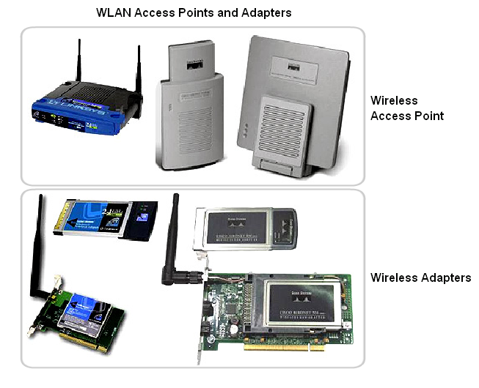
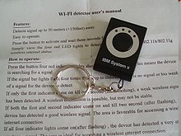
Characteristics & Uses of Network Media
Wireless Access Point (AP) - An access point (or hotspot) has a range of about 20 meters (65 feet) indoors and a greater range outdoors. Multiple overlapping access points can cover large areas.
Wireless NIC adapters - Provides wireless communication capability to each network host.
A keychain-size Wi-Fi detector

Slide 18
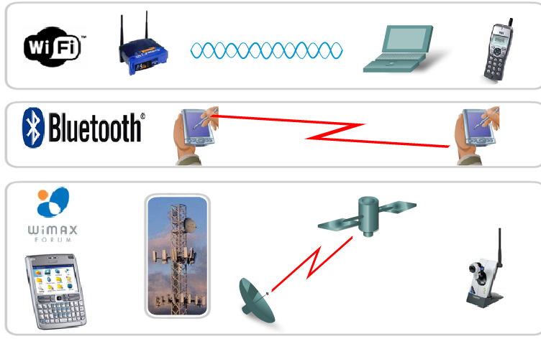
Characteristics & Uses of Network Media
Wireless Standards
Standard IEEE 802.11 - Commonly referred to as Wi-Fi, is a Wireless LAN (WLAN) technology that uses Carrier Sense Multiple Access/Collision Avoidance (CSMA/CA) media access process.
Standard IEEE 802.15 - Wireless Personal Area Network (WPAN) standard, commonly known as "Bluetooth", uses a device pairing process to communicate over distances from 1 to 100 meters.
Standard IEEE 802.16 - Commonly known as WiMAX (Worldwide Interoperability for Microwave Access), uses a point-to-multipoint topology to provide wireless broadband access.
Global System for Mobile Communications (GSM) - Includes Physical layer specifications that enable the implementation of the Layer 2 General Packet Radio Service (GPRS) protocol to provide data transfer over mobile cellular telephony networks.

